Slide 1
Beginning of the Cold War
1945-1991

Slide 2


What is it?
Cold war: a state of political hostility between countries characterized by threats, propaganda, and other measures short of open warfare
The Cold War: conflict between the United States and the Soviet Union in which neither nation directly confronted the other on the battlefield

Slide 3
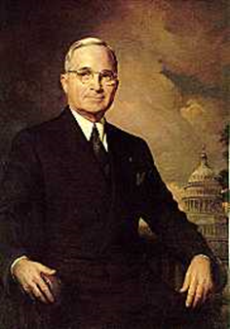
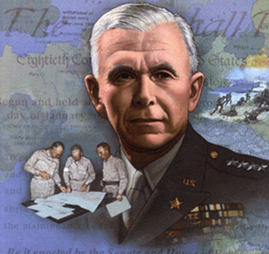
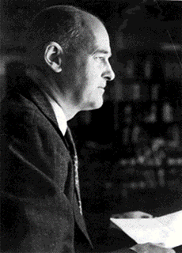
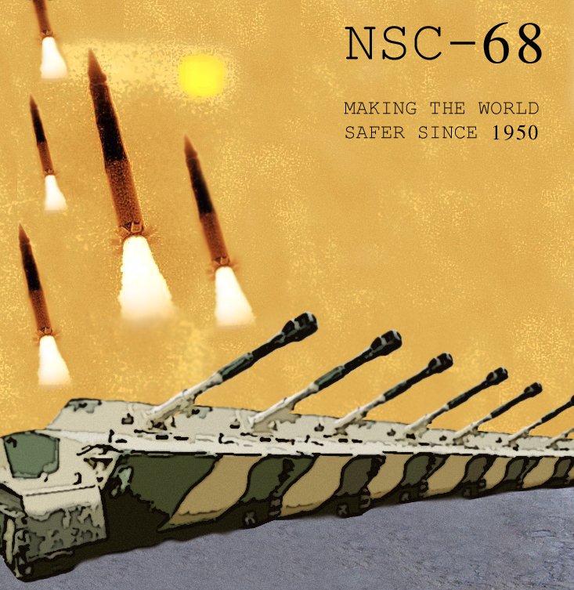
United States objectives
Truman Doctrine
  Aid free people against “armed minorities and outside forces”/ Greece & Turkey
Marshall Plan
  Economic aid to W. Europe/military presence
Kennan’s X-Article
  Containment
NSC-68
  Containment/military build-up

Slide 4

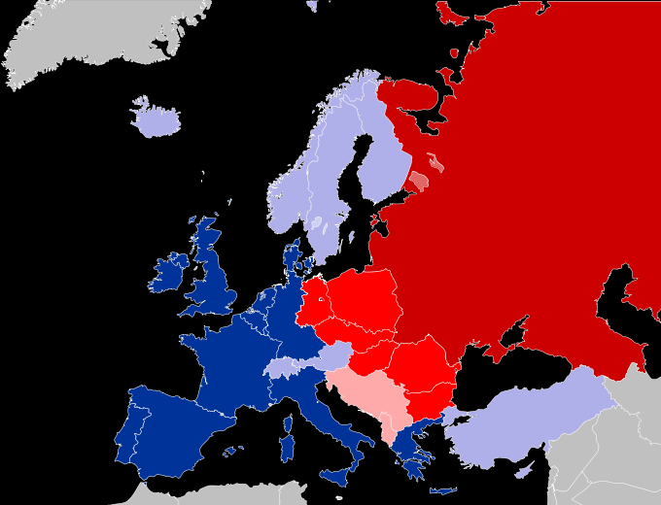
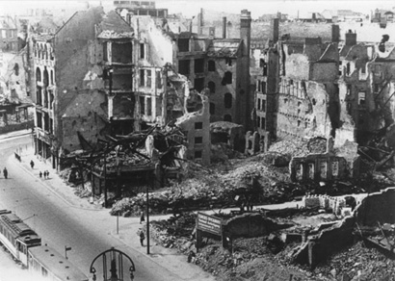
Perceived Soviet objectives
Destroy Germany (revenge)
Dominate Eastern European border states (satellite countries)
Increase economic and political influence through forced spread of communism

Slide 5
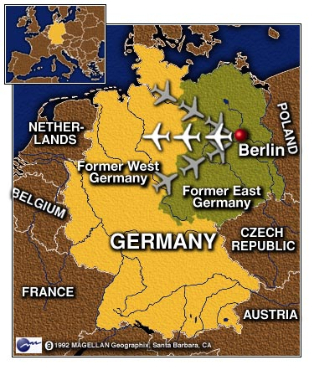
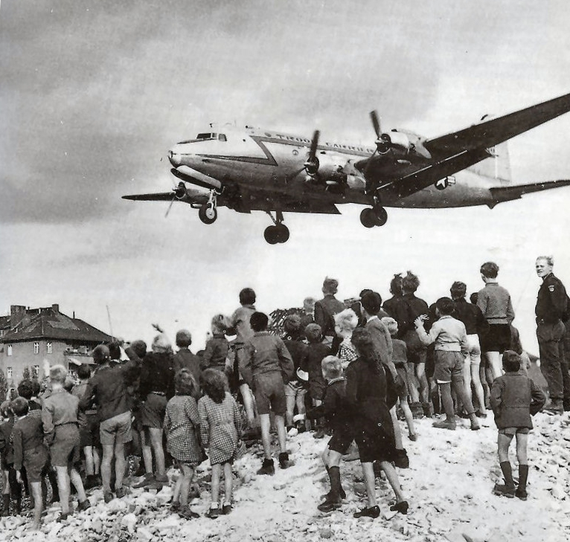
Berlin Airlift (1948-1949)
Germany Divided after WWII
Allies is blocked from Berlin by USSR
Eventually there is building of berlin Wall

Slide 6
North Atlantic Treaty Organization (NATO): 1949
NATO is a multi-state coalition between Europe and North America. It was formed as a faction against the Soviet Union
The central clause of the treaty clearly says:
The parties commit to the belief that an unarmed assault on one or more of them in Europe or North America shall be considered an attack against them both. In the case that this ever occurs, the parties furthermore agree to the belief that they will support the group or parties threatened by taking steps if it considers necessary, including the use of military forces, to restore and maintain the stability of the North Atlantic region.

Slide 7
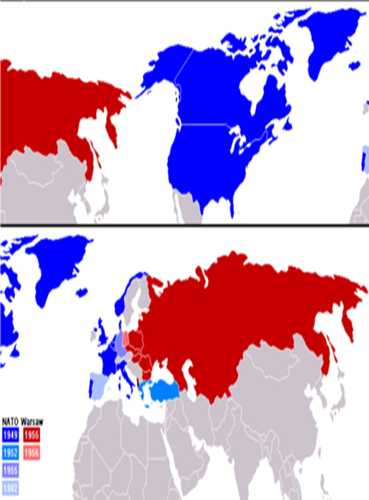
NATO vs. Warsaw Pact
NATO
  There is a security partnership between the U.S. and Europe (still exists)
Warsaw Pact:
  The Soviet Union and its satellites also formed a coalition called the Warsaw Treaty Organisation (Coker, & Tyson1985).

Slide 8
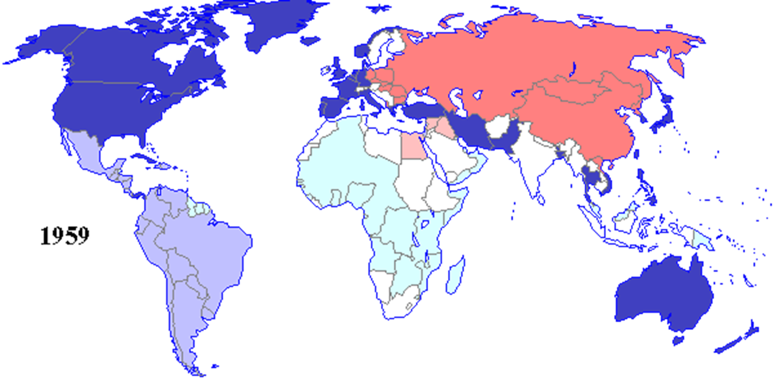
A world Divided: 1959

Slide 9
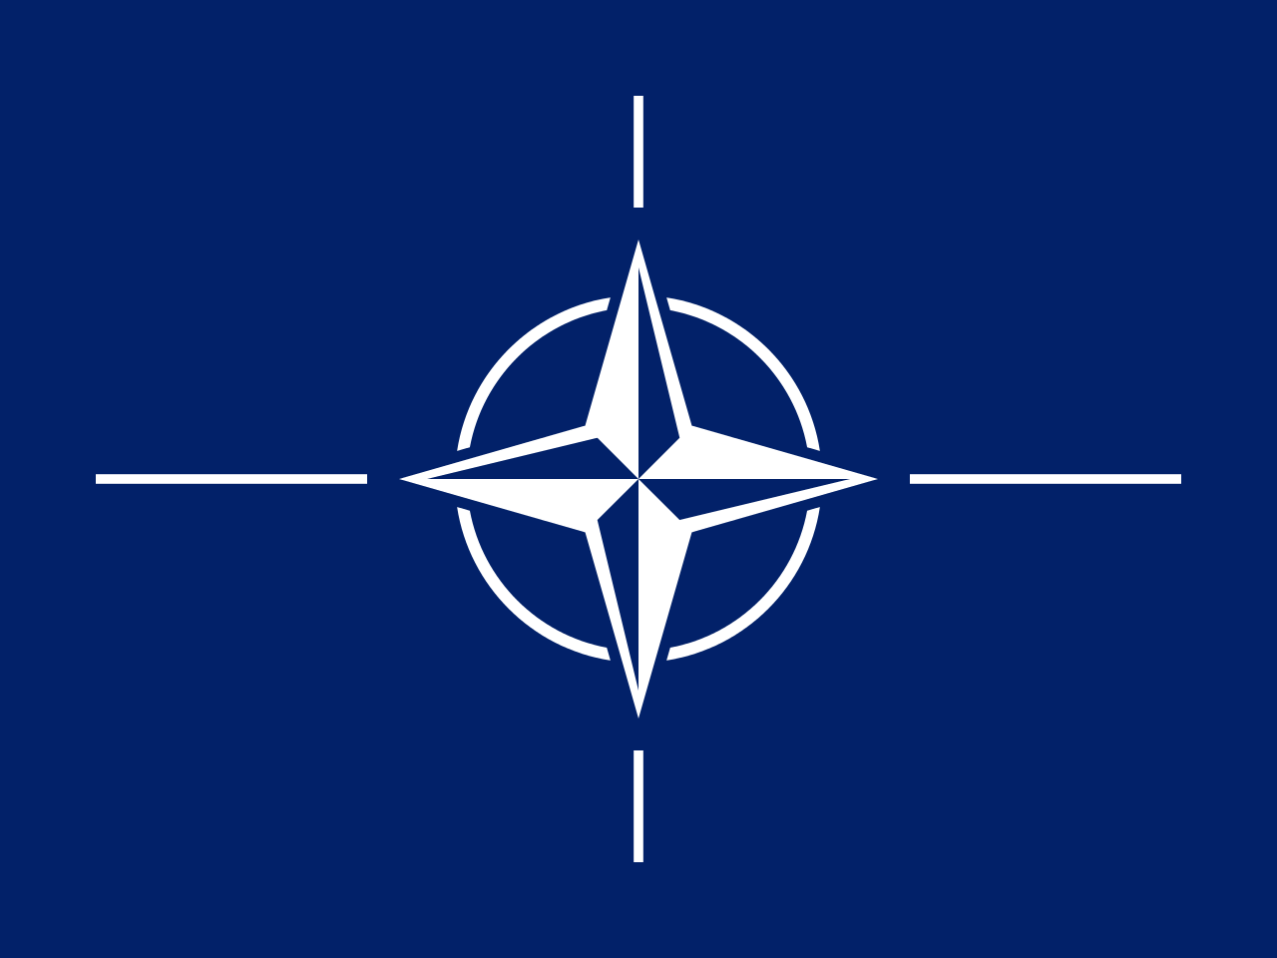
North Atlantic Treaty Organization (NATO)(1949)
Denmark
France
Ireland
Italy
United States
Belgium
Britain
Canada
Portugal
Greece & Turkey (1952)
West Germany (1955)
Spain (1983)
Luxembourg
Netherlands
Norway

Slide 10

Warsaw Pact (1955)
East Germany
Hungary
Poland
Romania
U.S.S.R.
Albania
Bulgaria
Czechoslovakia

Slide 11
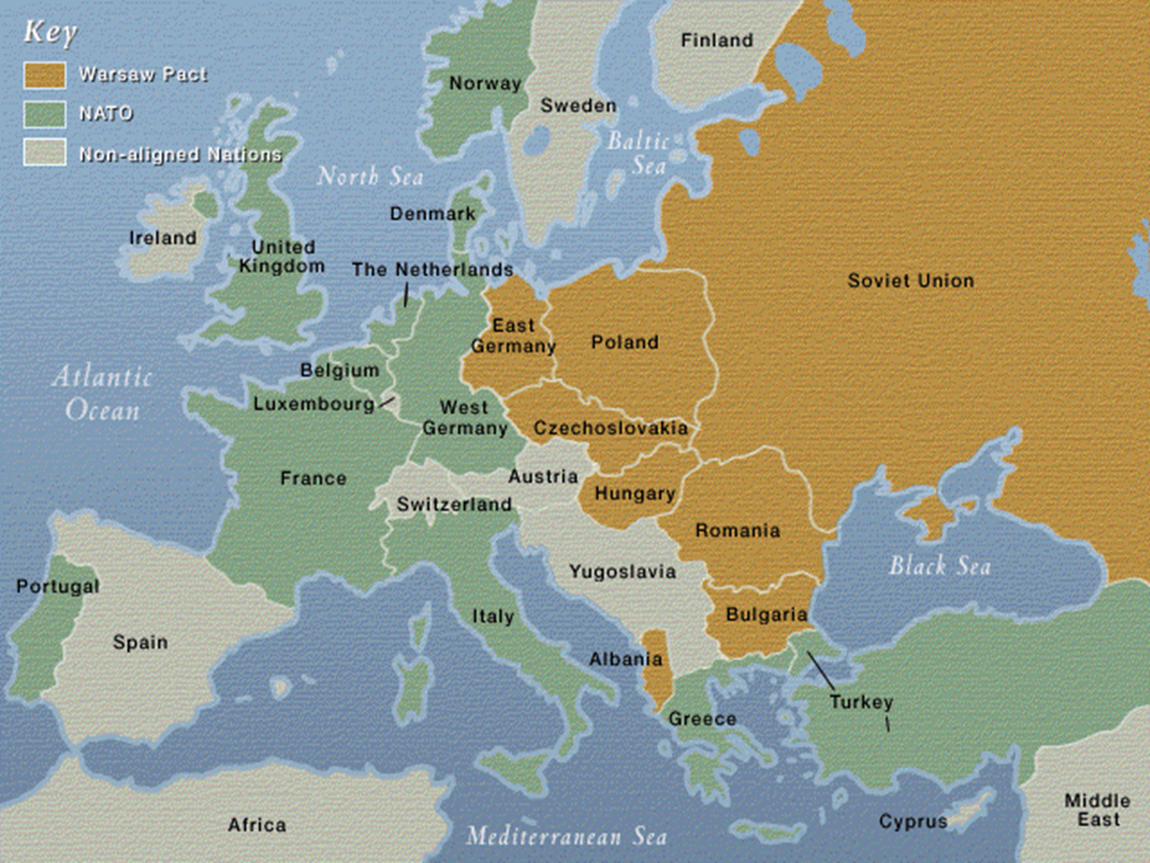

Slide 12
REFERENCE
Coker, C., & Tyson, H. (1985). NATO, the Warsaw pact and Africa. Springer.

